Slide 1
Cloud Security

Slide 2
Content
Cloud Security Overview
Optimize Security Operations in the Cloud Through the Lens of the NIST Framework
How to Build a Data Security Strategy in AWS
Linux tools for security analysis

Slide 3
Overview
As a security professional, you need to do three things in parallel:
• Understand how the major cloud providers work and the plenitude of services that they offer.
• Understand the technical details of each platform to ensure that you have secured your specific implementation appropriately.
• Ensure your teams transform the way they do their work in order to leverage cloud services and automation in a way that improves the effectiveness of security itself.”

Slide 4
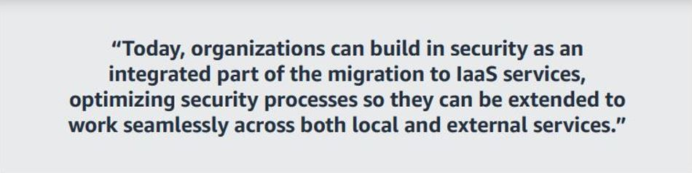

Slide 5
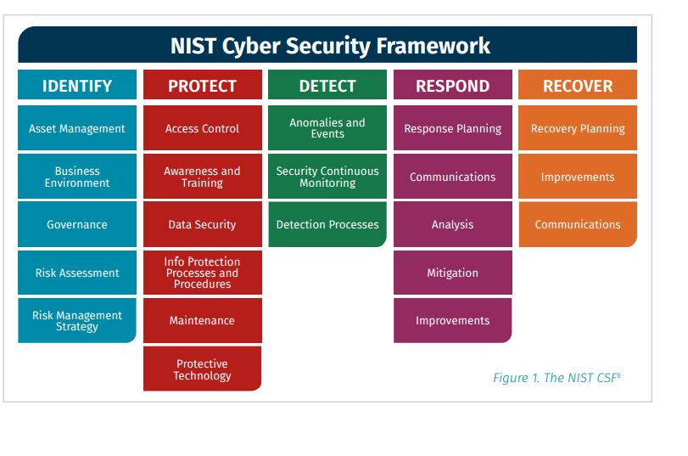

Slide 6
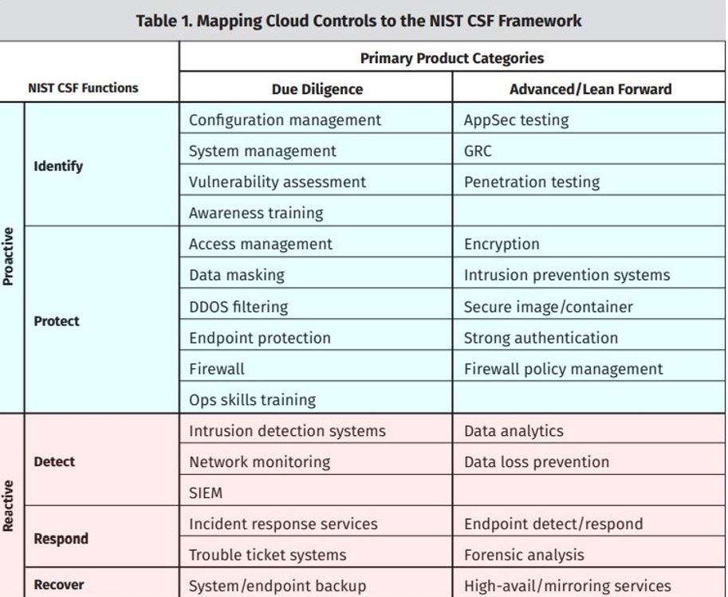

Slide 7
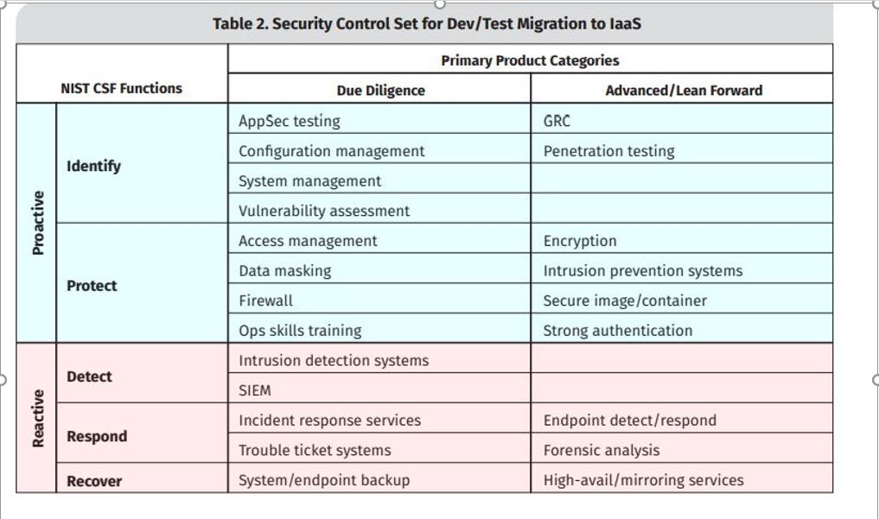

Slide 8
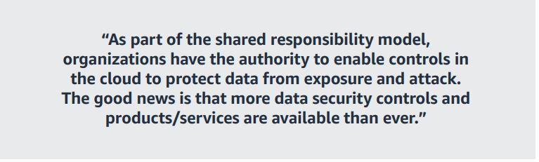

Slide 9
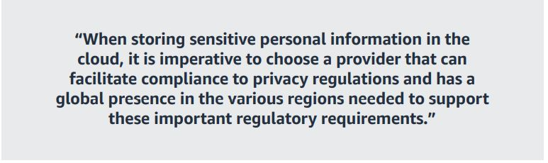

Slide 10
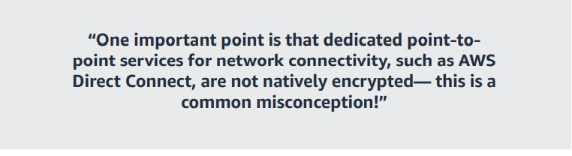

Slide 11
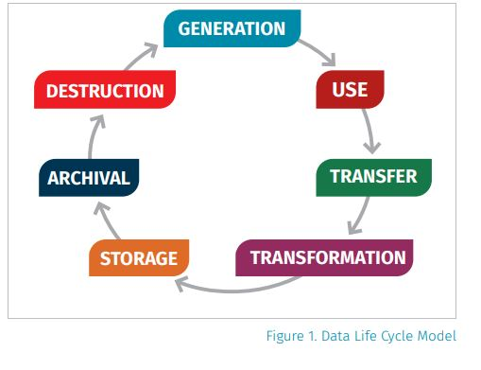

Slide 12
Tools used in Security assessments in cloud
Cloud Security Audit is a command line tool that scans for vulnerabilities in your AWS Account
Pacu : This package contains an open-source AWS exploitation framework, designed for offensive security testing against cloud environments. Created and maintained by Rhino Security Labs, Pacu allows penetration testers to exploit configuration flaws within an AWS account, using modules to easily expand its functionality. Current modules enable a range of attacks, including user privilege escalation, backdooring of IAM users, attacking vulnerable Lambda functions, and much more.

Slide 13
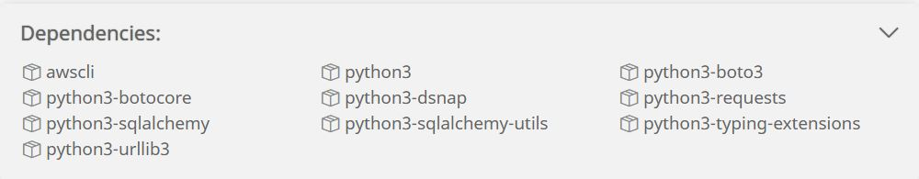

Slide 14
root@kali:~# pacu -h
usage: pacu [-h] [--session] [--module-name] [--data] [--module-args] [--list-modules] [--pacu-help] [--module-info] [--exec] [--set-regions [...]] [--whoami]
optional arguments: -h,
--help show this help message and exit
--session <session name>
--module-name <module name>
--data <service name/all>
--module-args <
--module-args=‘
--regions us-east-1,us-east-1’>
--list-modules List arguments
--pacu-help List the Pacu help window
--module-info Get information on a specific module,
use --module- name
--exec exec module
--set-regions [ ...] <region1 region2 ...> or <all> for all --whoami Display information on current IAM user

Slide 15
THE END

